Slide 1
Natural batteries
Moiseev Vladislav PIN-22

Slide 2
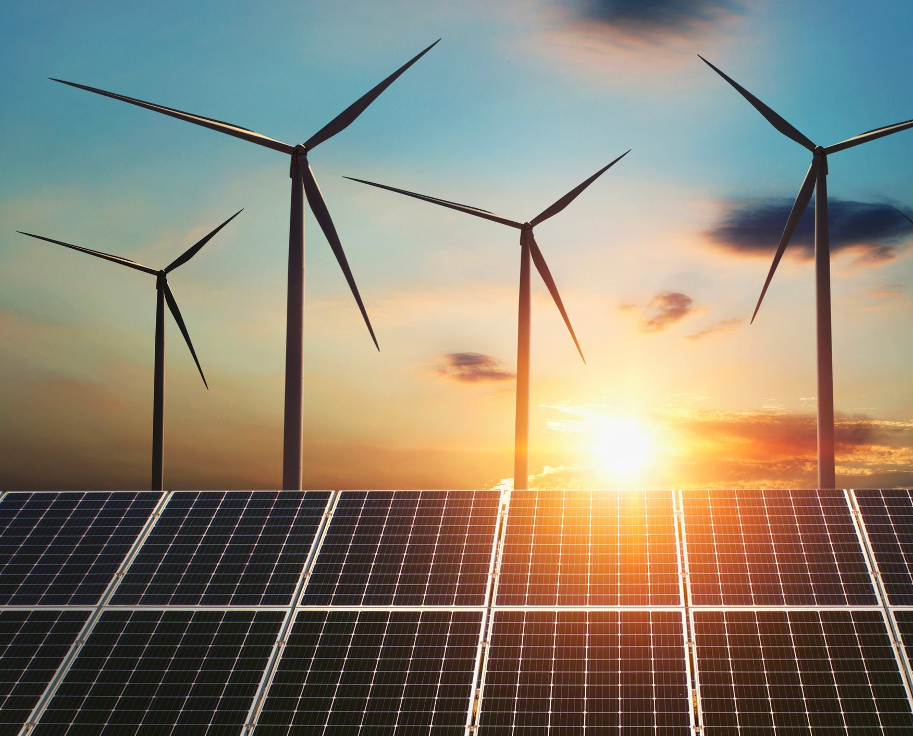
Green energy problem
One of the biggest problem to transitioning to 100% green energy is that renewable sources don’t always generate electricity when we want them to.
The solution to this trouble is storage – capturing green energy when there’s too much and returning it when there’s too little.

Slide 3
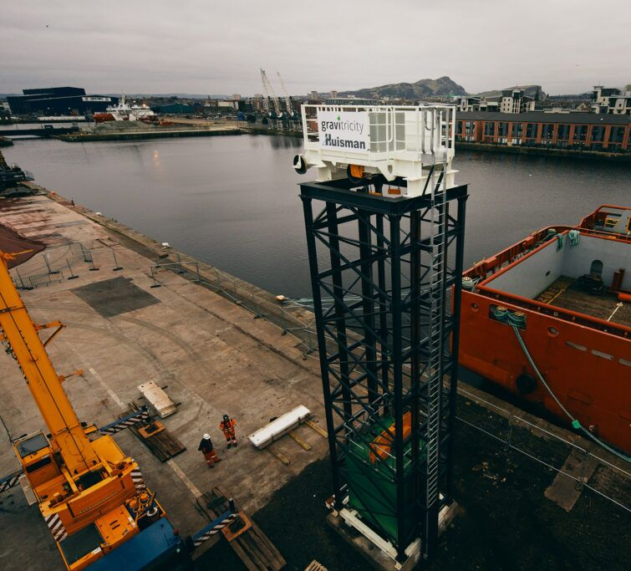
Gravity batteries
All batteries work in the same way: they store electrical energy as a form of potential energy. In the case of gravity batteries, the electrical energy is stored as gravitational potential energy. That is, the energy an object would release should it be allowed to fall towards the earth’s center.
Gravity batteries make this conversion by using override electricity generated by a renewable energy source to lift up a heavy weight. The denser the material, the more energy the system can store.
(Gravitricity – company
that create gravity battery)

Slide 4


Positive aspects
release between 1 megawatt (MW) and 20MW at peak power and output energy for up to eight hours.
This system could power 63,000 homes for every hour that it discharges.
Gravity battery can effectively be recharged an unlimited number of times, assuming it is properly maintained.
The battery would absorb override solar energy during the day when the sun is up and release it all night long when it’s dark.
Negative aspects
Gravity batteries are little suitable for storage wind power, which is less predictable

Slide 5
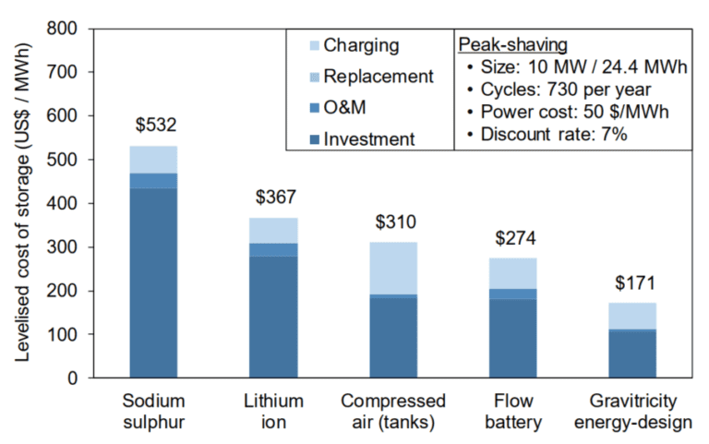
Competitive ability
According to Imperial College London, Gravitricity's theoretical system could store energy at a cost of just $171 per megawatt-hour (MWh). It is much cheaper than alternatives.
Gravitricity is hoping to complete construction on the full-scale underground system for some European villages in 2023 or 2024.

Slide 6
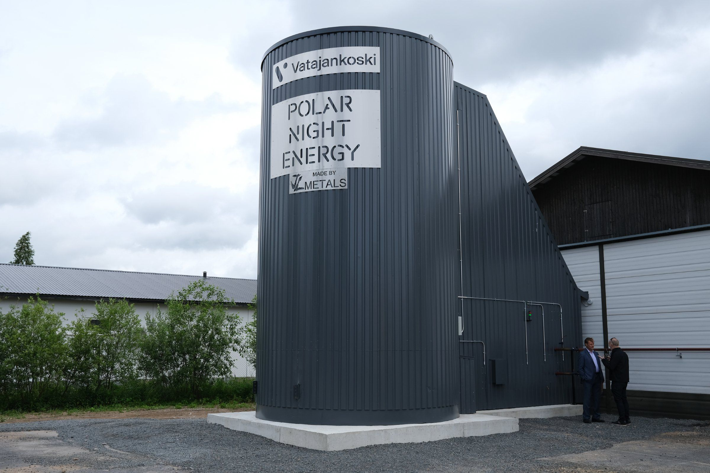
Sand batteries
A “sand battery” is a high temperature thermal energy storage that uses sand or sand-like materials. It stores energy in sand as heat.
Its main purpose is to work as a high-power and high-capacity tank for excess wind and solar energy. The energy is stored as heat, which can be used to heat homes, or to provide hot steam to industries that are often fossil-fuel dependent.

Slide 7
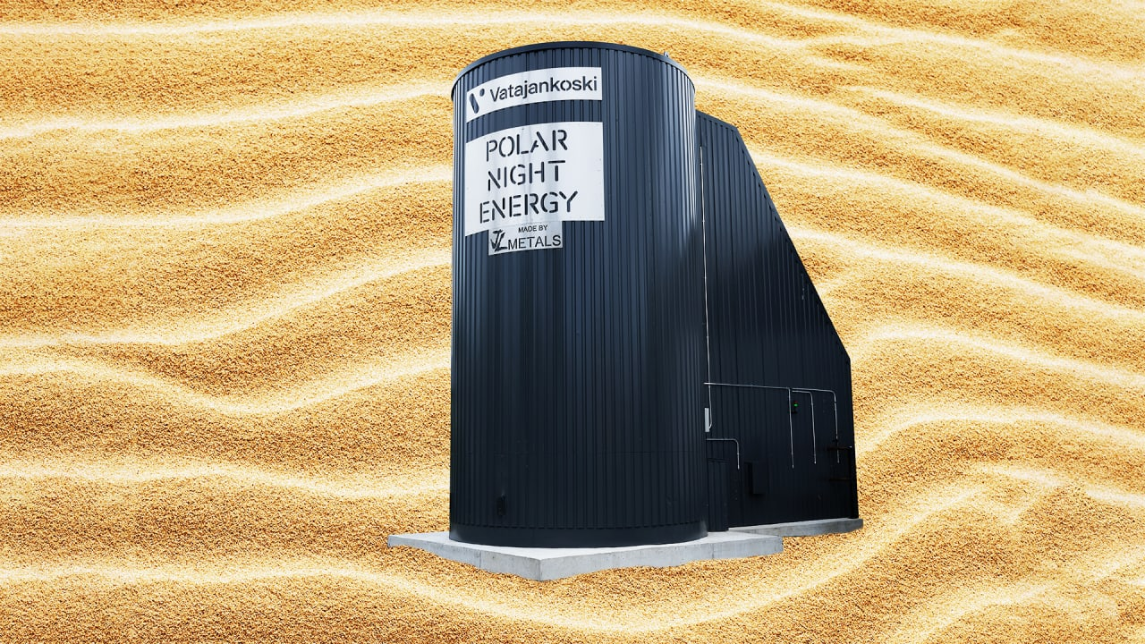
The first commercial sand battery in the world is in a town called Kankaanpää, Western Finland. It is connected to a district heating network and heating residential and commercial. The district heating network is operated by an energy utility called Vatajankoski.

Slide 8
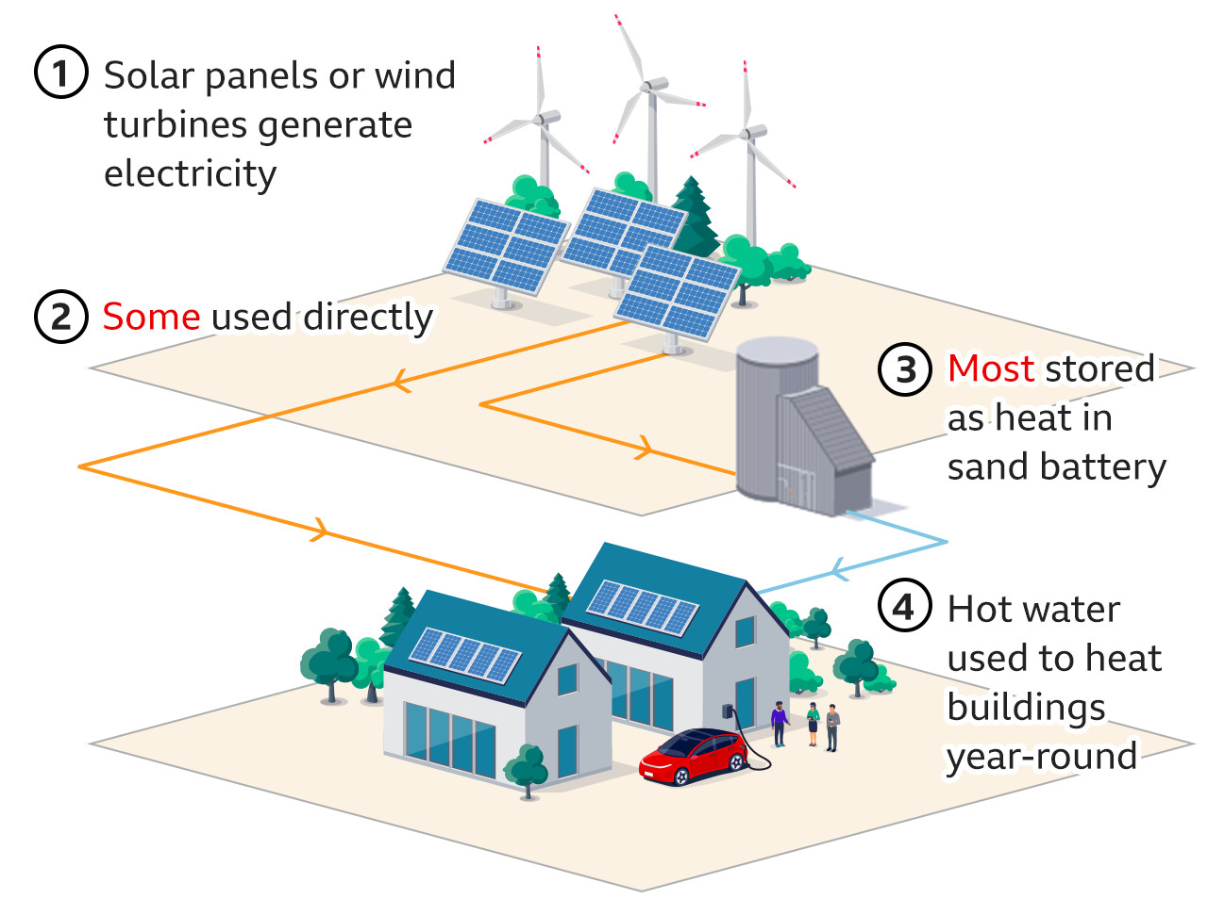
How it works
We charge it when clean and cheap electricity is available. The electrical energy is transferred to the heat storage using a closed loop air-pipe. Air is heated up using electrical resistors and circulated in the heat transfer piping.
The maximum temperature in the heat storage is about 600 degrees Celsius.
The heat can be converted back to electricity using turbines like the ORC-turbine or a steam turbine. BUT it is absolutely not profitable

Slide 9

Thanks for
your attention
Take care of nature
Gravity
and sand
batteries

Slide 10
Links
https://interestingengineering.com/innovation/worlds-first-sand-battery
https://polarnightenergy.fi/sand-battery
https://granttree.co.uk/blog/innovative/gravity-batteries/
https://en.wikipedia.org/wiki/Gravity_battery

